Slide 1
Supply Chain Management - Case Study 1
Steel Works, Inc.

Slide 2
Problems
Worsening customer service levels
Falling sales
Rising expenses
Customers threatening to move to competitors

Slide 3
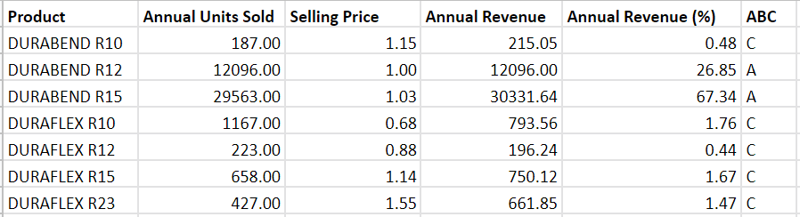
Product Classification
ABC analysis based on revenue generated
Priority products: Durabend R12 and Durabend R15
Notes:
We performed ABC analysis on the given data to classify the products into high priority (type A) and low priority (type C) based on the revenue generated by each of the items.

Slide 4
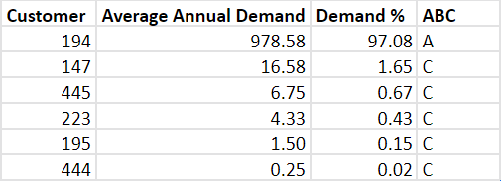
Customer Classification (based on Durabend R12)
Customer 194 contributes to most of the demand.

Slide 5
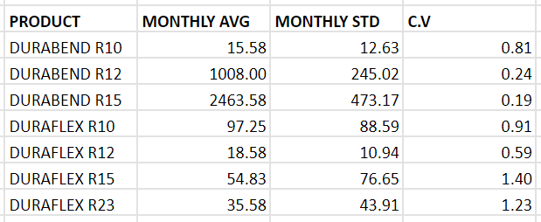
Coefficient of Variation of Demand
Coefficient of variation quantifies the fluctuation around the average monthly demand.
Notes:
The coefficient of variation (CV) is the ratio of the standard deviation to the mean. The higher the coefficient of variation, the greater the level of dispersion around the mean. The lower the value of the coefficient of variation, the more precise the estimate. Durabend R12 and Durabend R15 have low coefficient of variation meaning that their predicted monthly avg is likely to be closer to the actual monthly demand. f

Slide 6
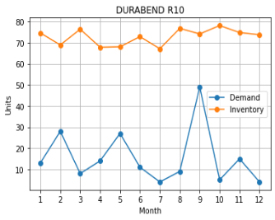
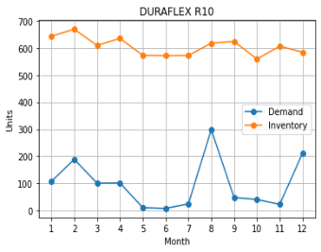
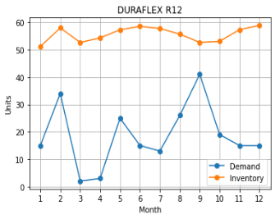
Current Inventory:
Current average monthly inventory vs average monthly demand for each product
Notes:
We found that for the products Durabend R10, Duraflex R10, Duraflex R12, Duraflex R15 and Duraflex R23, they’re grossly overestimating the demand.

Slide 7
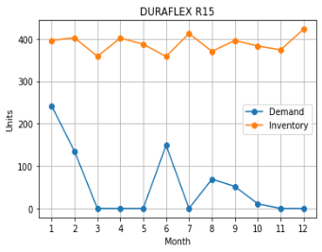
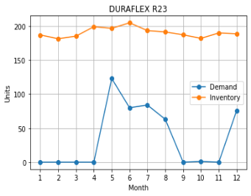
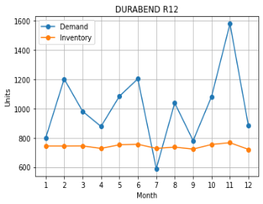
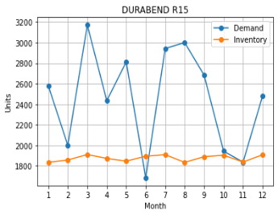
Notes:
We found that for the products Durabend R12 and Durabend R15,they’re grossly underestimating the demand

Slide 8
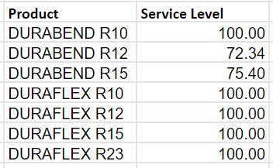
Service Level: Current
High priority products have bad service level
Notes:
The high priority products that bring in the most revenue (A type) have the worst service level. The focus is on the wrong products.

Slide 9
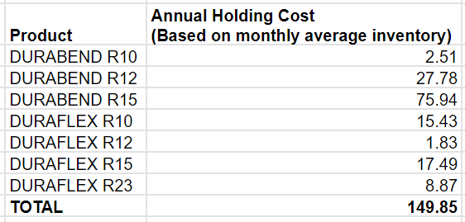
Holding Costs: Current
Assumption: Holding cost is 15% of cost price per unit per annum.

Slide 10
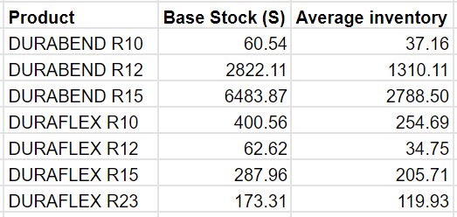
Proposed Inventory Policy
Periodic Review Policy (period = 1 month)
Notes:
We propose a periodic review policy with a period of one month (so that the production cycle does not have to be changed). We calculate a base stock value or order upto value for each of the products. This means that the inventory for each product has to be checked every month, and orders should be placed keeping the proposed base stock in mind.

Slide 11
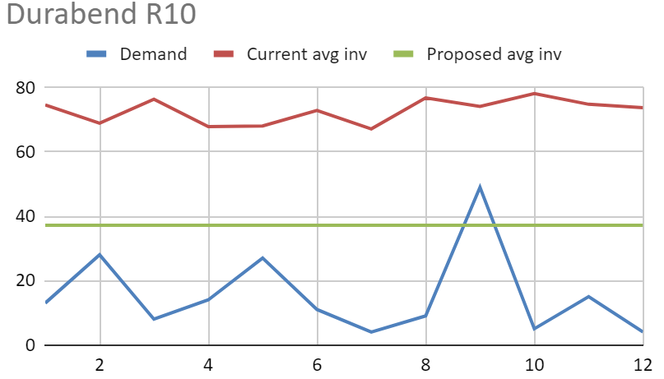
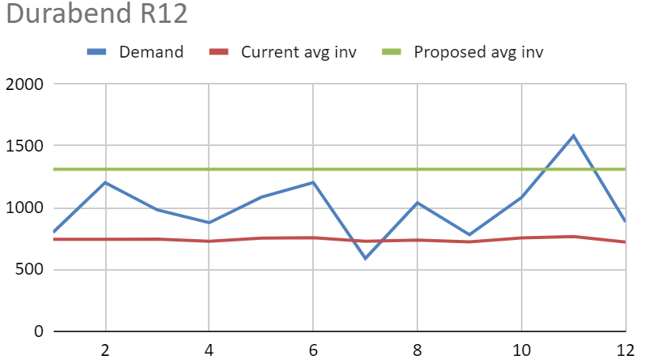
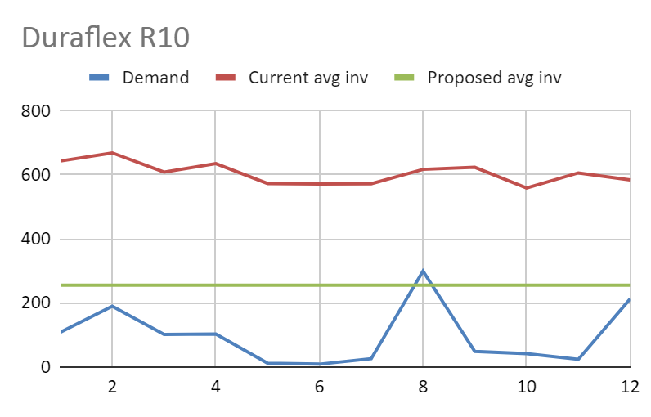
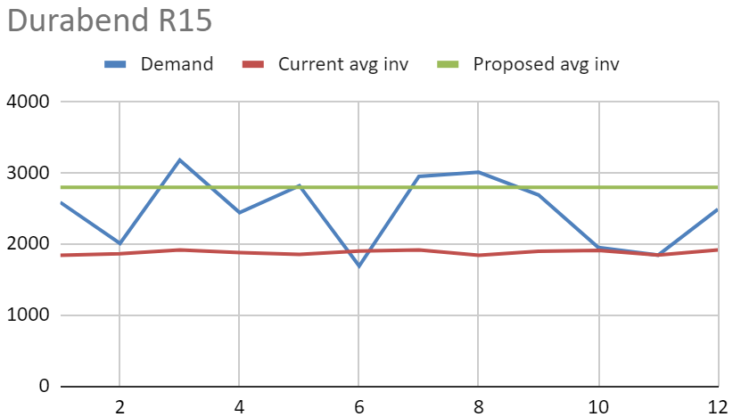
Current, Proposed Inventory vs Demand

Slide 12
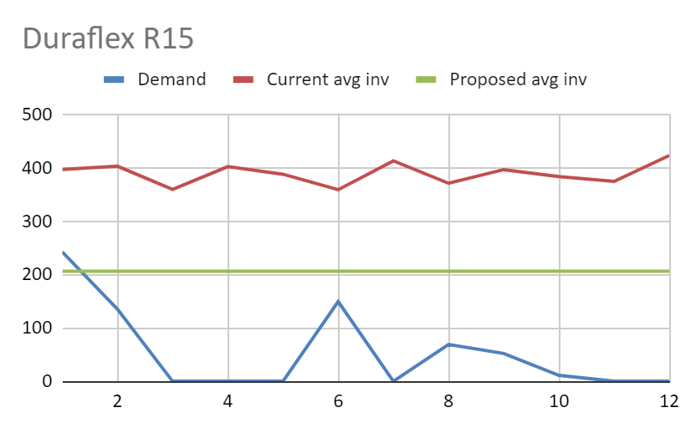
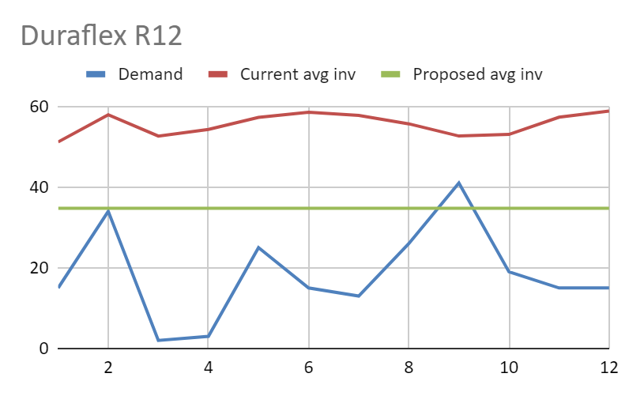
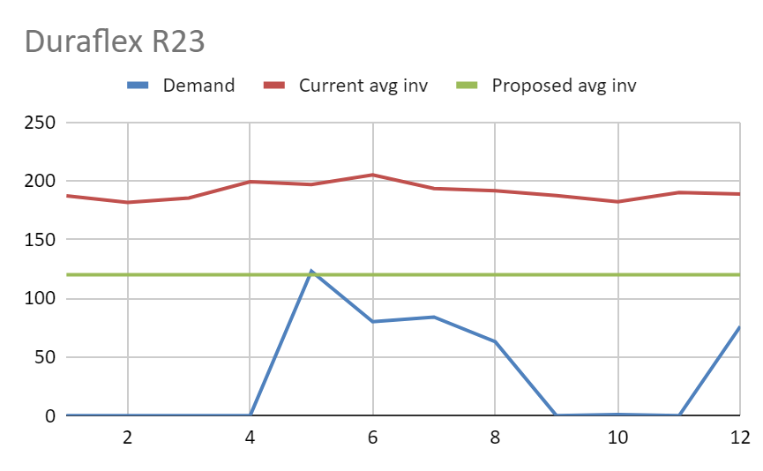

Slide 13
Analysis - new policy vs old policy

Slide 14
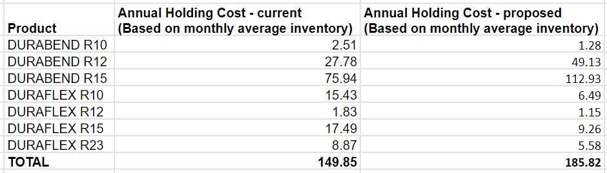
Holding Cost Estimation
~$36k increase in holding cost

Slide 15
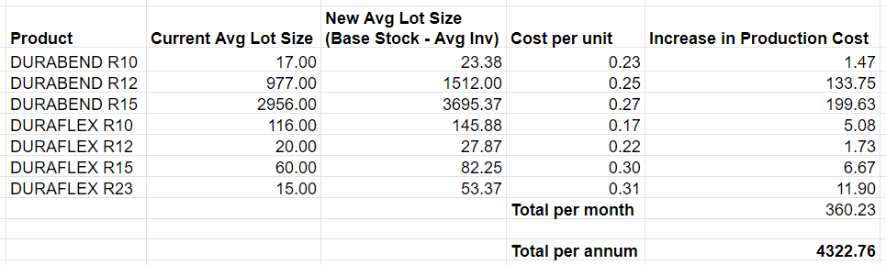
Estimated Increase of Production Cost

Slide 16
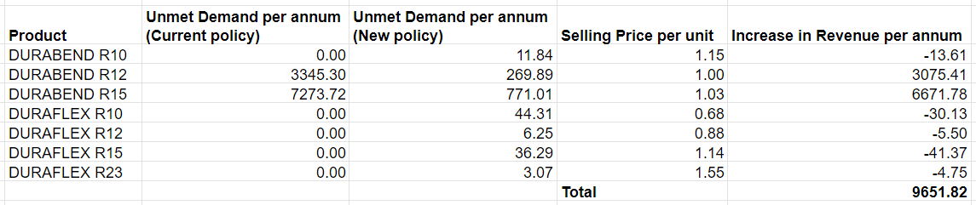
Estimated Increase in Revenue

Slide 17
Evaluating the new policy
Estimated increase in holding costs ~ $35,980
Estimated increase in production costs ~ $4,322,760
Estimated increase in revenue ~ $9,651,820
No change to production cycle frequency → no change in set up costs
Estimated increase in profit ~ $5,293,080

Slide 18
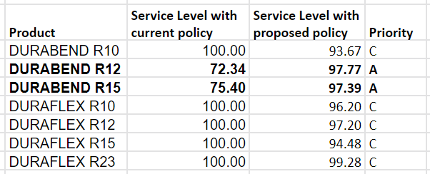
Service Level
Increased service level of high priority products
Slightly compromised on service levels of low priority products
Notes:
We also calculated the service level we would achieve if the proposed policy is implemented. We see that the service levels of our high priority products, durabend r12 and durabend r15 goes up drastically. We do also see that the service levels of our low priority products go down slightly, but this will cause a very mild impact on our profits when compared to the increased profits from our high priority products.

Slide 19
Custom Products Division
It seems like the inventory levels of the products are disproportionate to their demands. Increase production frequency of fast moving products/products bought by high priority customers and decrease the frequency for slow moving products.
Adapt a more frequent review policy for products with highly fluctuating demand or products with high priority customers to ensure tighter control.
The two divisions seem to be functioning completely independently of each other. A more collaborative system with sharing of resources like warehouses, factories and transportation might be a good cost cutting measure.

